Slide 1
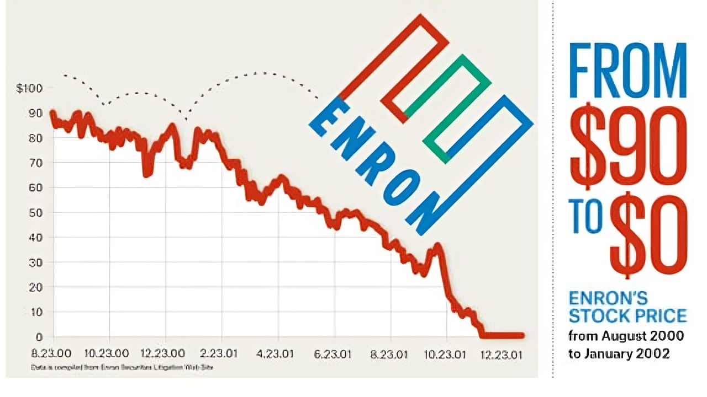

Analyzing the Enron Email Dataset
Tanishq Salkar, Cindy Jiang, Rachael Sproule, Jacob Graber
April 16, 2024

Slide 2
Introductions

Slide 3
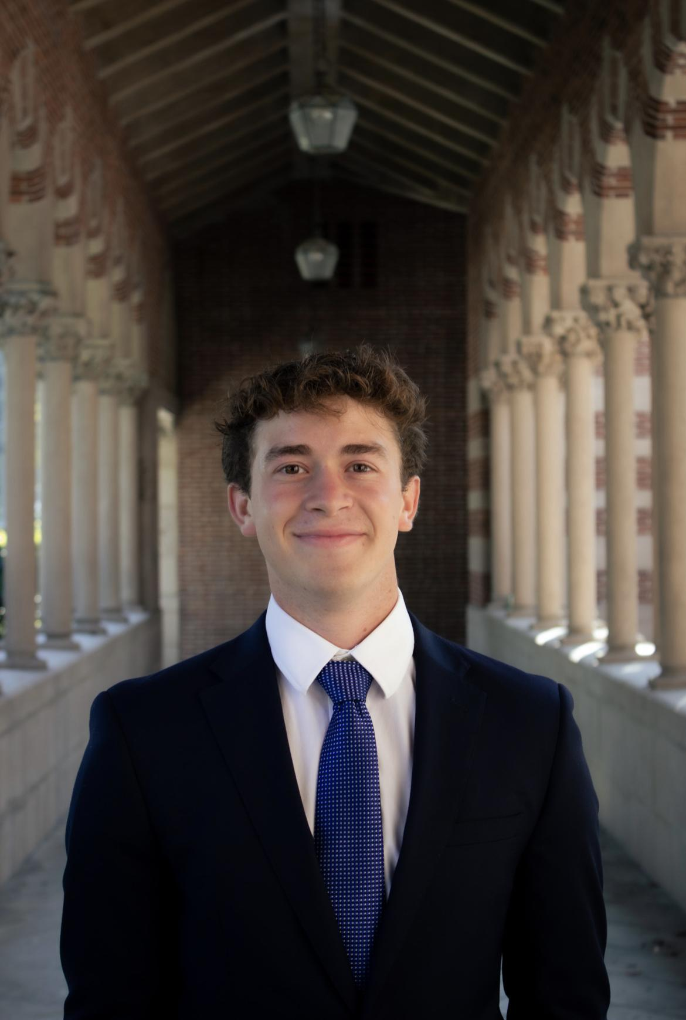



Meet the Team
Jacob Graber
M.S. Applied Data Science
B.S. Business Administration
Tanishq Salkar
M.S Applied Data Science
B.Tech Electronics Engineering
Cindy Jiang
M.S Communication Data Science
B.A. Communication
Rachael Sproule
Graduate Certificate in Data Science Foundations
B.A. Physics

Slide 4
Problem Scope
Notes:
Cindy

Slide 5



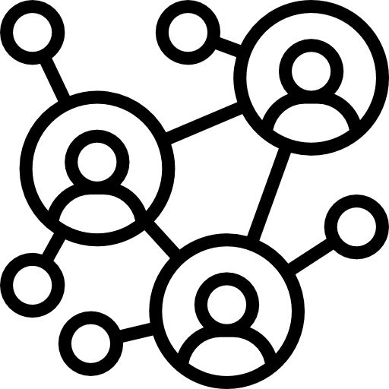
Agenda
Problem Scope & EDA
Dive deeper into problem scope & perform exploratory data analysis on ENRON email dataset
Time Series Analysis
Identification of trends in email activity & attempts of different methods for predicting email volume
NLP Analysis
Key takeaways from sentiment analysis and keyword analysis of email contents
Network Analysis
Identification of key players & analysis of overall communication patterns in the ENRON network

Slide 6

Problem Scope
Key Question: Can we utilize a dataset containing 500,000 emails sent by employees of the ENRON Corporation to try to understand the relationship between the employees and hypothesize the reasons for the Collapse of ENRON Corp.?
Initial Situation
ENRON declared bankruptcy in December of 2001, but trouble had been brewing much longer
We have a dataset of 500,000 emails between employees of ENRON Corp in the period leading up to the collapse
Success Criteria
Constraints
New insights into what may have led to the collapse of ENRON
Predictions of email volume based on historical data (using LSTM)
Identification of key players and communities at ENRON via network analysis
Data constraint: messy or weak data collection could lead to problems during analysis
Lack of insight into ENRON’s organizational structure or real timeline of events
Computational limitations
Notes:
to understand the relationship between the employees and hypothesize the reasons for collapse of ENRON Corp.

Slide 7
Exploratory Data Analysis
Notes:
Cindy

Slide 8
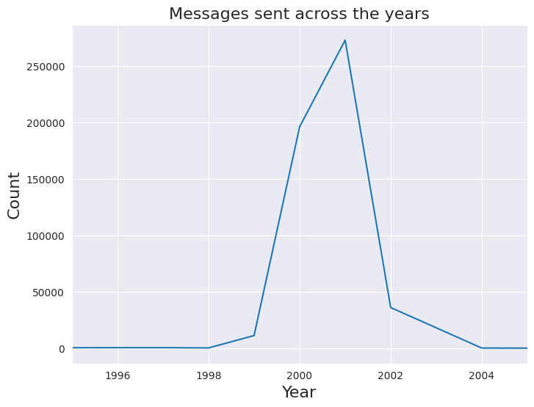
Rate of Emails Sent Over Time
Year | Count
2001 | 272964
2000 | 196100
2002 | 35974
1999 | 11144
1980 | 522
1997 | 437
1998 | 177
2004 | 70
2044 | 3
2020 | 2
2012 | 2
1986 | 2
2007 | 1
2005 | 1
2024 | 1
2043 | 1
Crucial Time Period
Noise
Messy Data

Slide 9
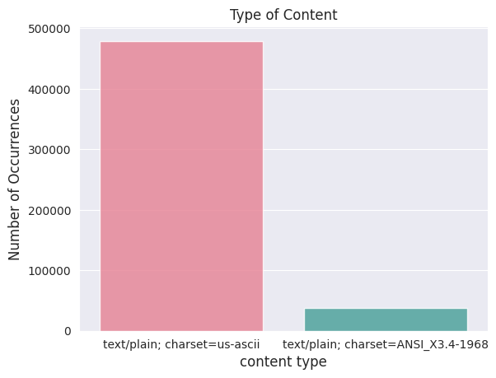
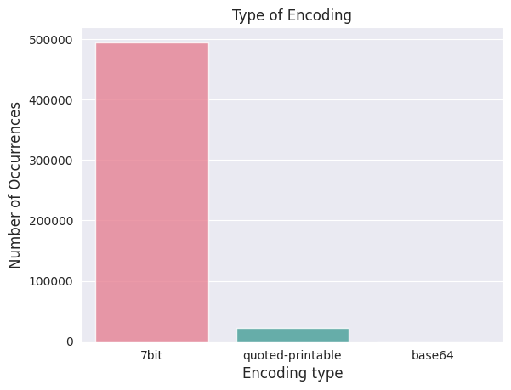
Types of Content Sent

Slide 10
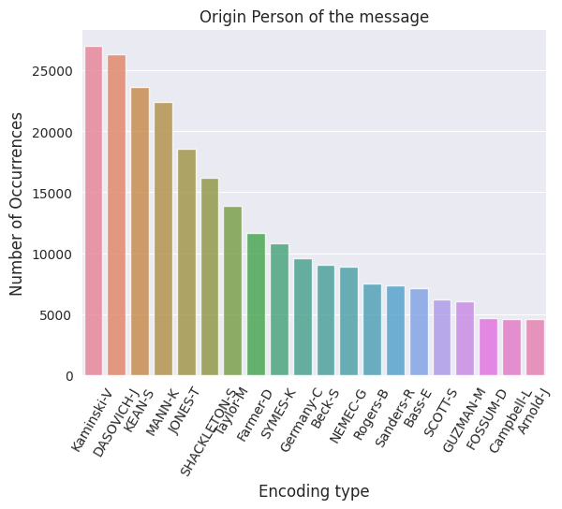
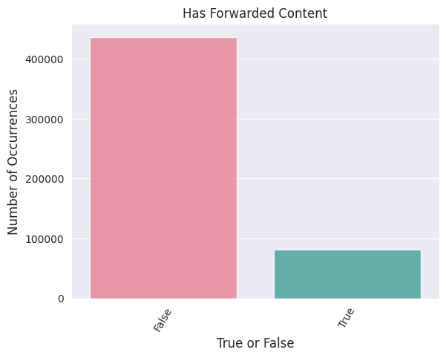
Forwarded Content

Slide 11
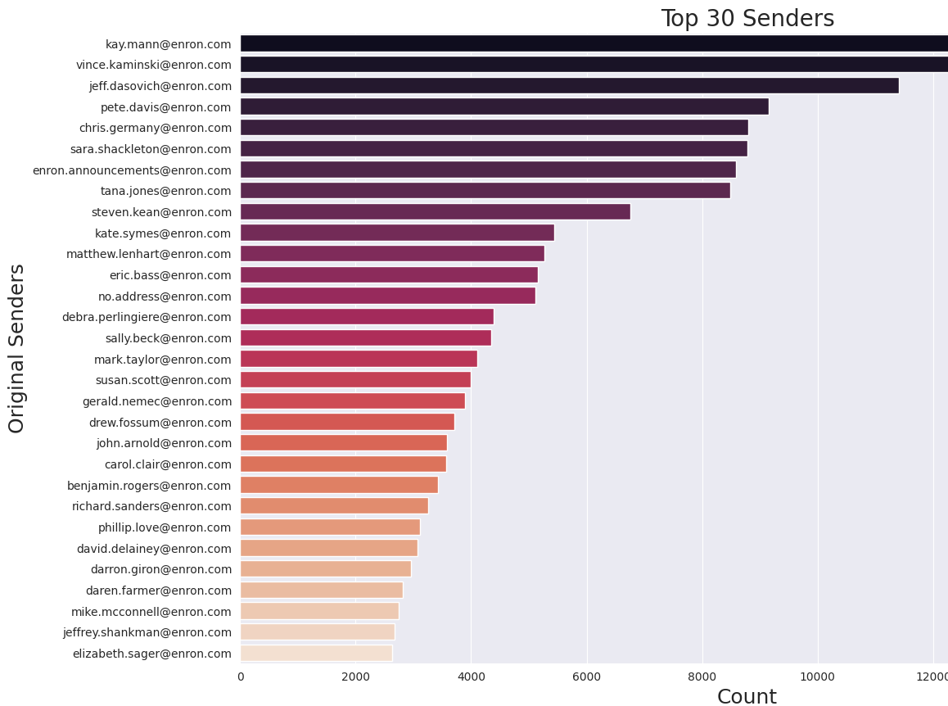
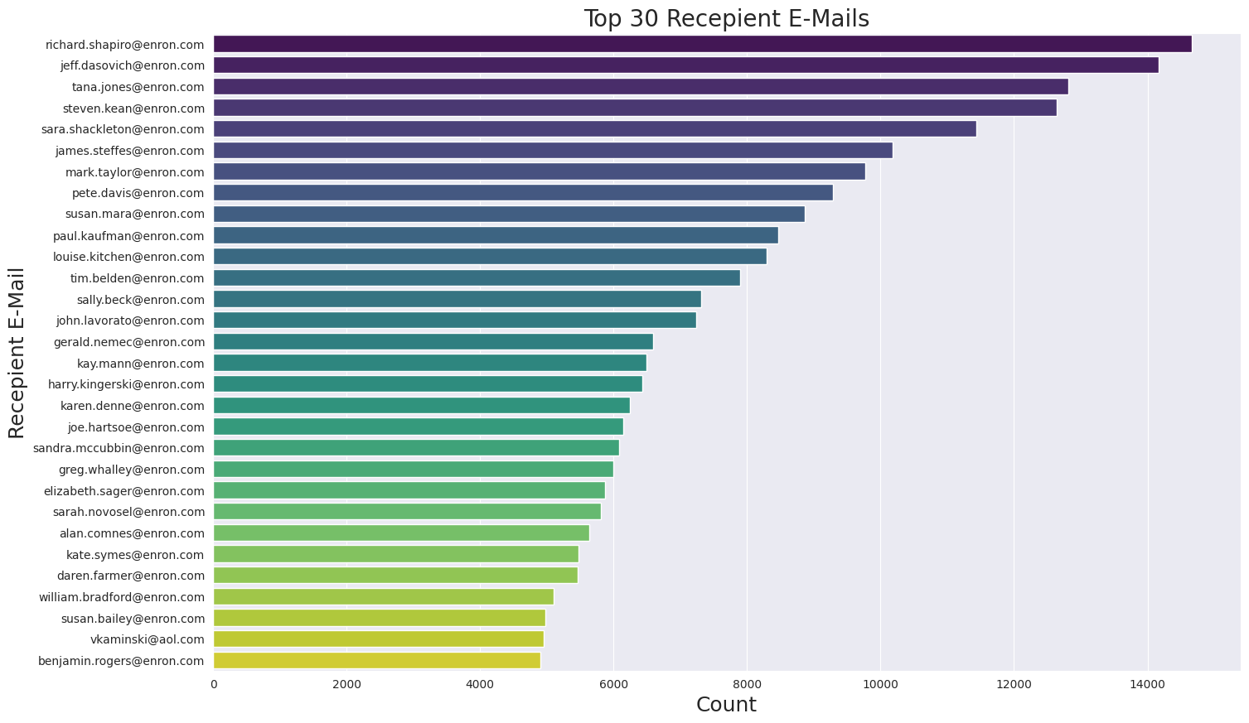
Most Common Email Senders & Recipients
Notes:
Selected top 30 for each category

Slide 12
Emails Leaving the Central Organization
Year | Total Count | Common Domains | Count
1999 | 115 | haas.berkeley.edu hotmail.com columbiaenergygroup.com earthlink.net sullcrom.com aol.com | 158 126 126 35 25 18
2000 | 1405 | txu.com aol.com hotmail.com columbiaenergygroup.com haas.berkeley.edu | 1058 1023 688 648 524
2001 | 3701 | aol.com hotmail.com mailman.enron.com carrfut.com nymex.com | 1351 1210 1098 1035 941
2002 | 1751 | aol.com hotmail.com mailman.enron.com yahoo.com carrfut.com rigzone.com | 409 401 336 319 256 245
Many emails were observed that had domain apart from enron
These showed that the some employees were interacting with other companies
One of the most common domain over the years is columbiaenergygroup.com
Observation
After analysing mail sent to and received from columbiaenergygroup.com it indicates communication regarding some business deals
Also observed that many employees were sending some emails to their personal email id’s many of which had hotmail.com domain
Identification

Slide 13
Time Series Analysis
Notes:
rachael

Slide 14
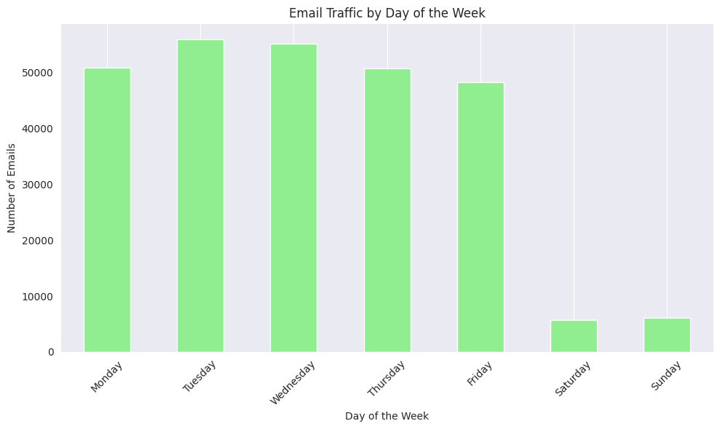
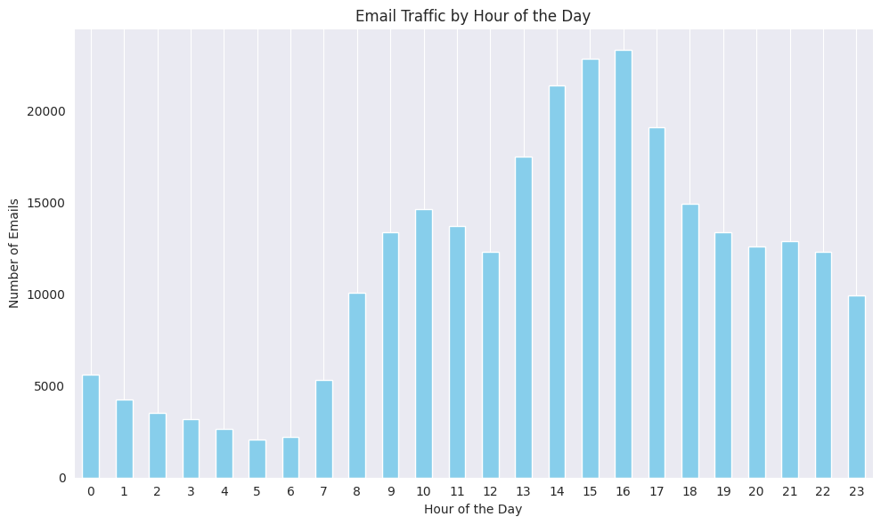
Email Traffic

Slide 15
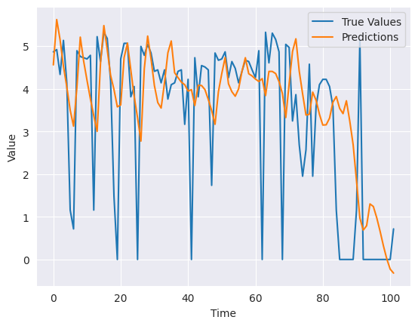
LSTM
Overview
Currently The Midnight Mission has events and plans in place ranging from posts to large events
Large Events:
110 Years Celebration on September 6, 2024
Easter Street Fair on March 31, 2024
Mother’s Day Event with Homelight Family Living Child Development on May 5, 2024
Golfing with Tim Allen on June 10, 2024
Small Events:
Thanksgiving
Art with a Mission
Santa’s Village
Other Plans
Throwback Thursday Posts
Goal: To determine if volume of emails could be predicted using LSTM on enron dataset
Conclusions
Identified the number of emails sent and received each day.
Used LSTM model to forecast future volume of emails
Mean Square Error: 2.35
Mean Absolute Error: 1.0927
Since mean square error is high this model is not accurate in predicting the volume of emails

Slide 16
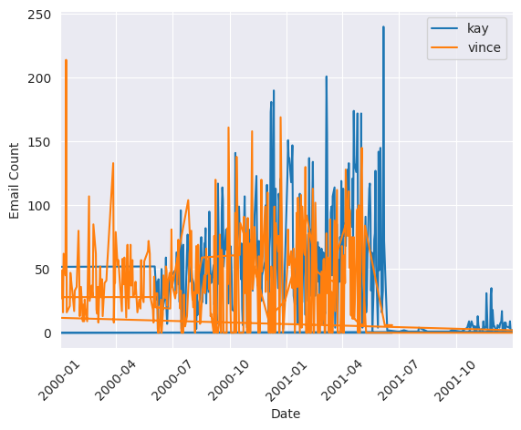
Granger Causality Test
Methodology
On top 2 senders :
kay.mann@enron.com → 16735 emails sent
vince.kaminski@enron.com → 14368 emails sent
Performed Granger causality test to identify if volume of mails sent by Kay Mann is useful in forecasting mails sent by Vince Kaminski
Observation
Test #1: Vince Kaminski volume of emails Granger causes Kay Mann emails → Yes! (p_value = 0.02125)
Test #2: Kay Mann volume of emails Granger causes Vince Kaminski emails → No. (p_value = 1)
Pearson Correlation Coefficient = 0.22054
Conclusion: Vince Kaminski’s volume of emails is useful in predicting Kay Mann’s.

Slide 17
NLP Analysis
Notes:
Tanishq

Slide 18
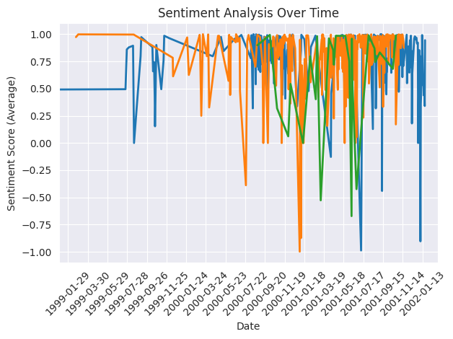
Sentiment Analysis of Key Figures at Enron
Sentiment analysis was performed on the emails of
Kenneth Lay: Founder and former Chairman and CEO of Enron
Jeffrey Skilling: Former CEO of Enron.
Andrew Fastow: Former CFO of Enron.
Key Takeaways
As visible from the graph we can see the sentiments going tremendously down in the year 2001.
Giving indication of major troubles at enron
For Jeffrey Skilling and Andrew Fastow we can see graph stops in middle of 2001.
Moving Forward

Slide 19
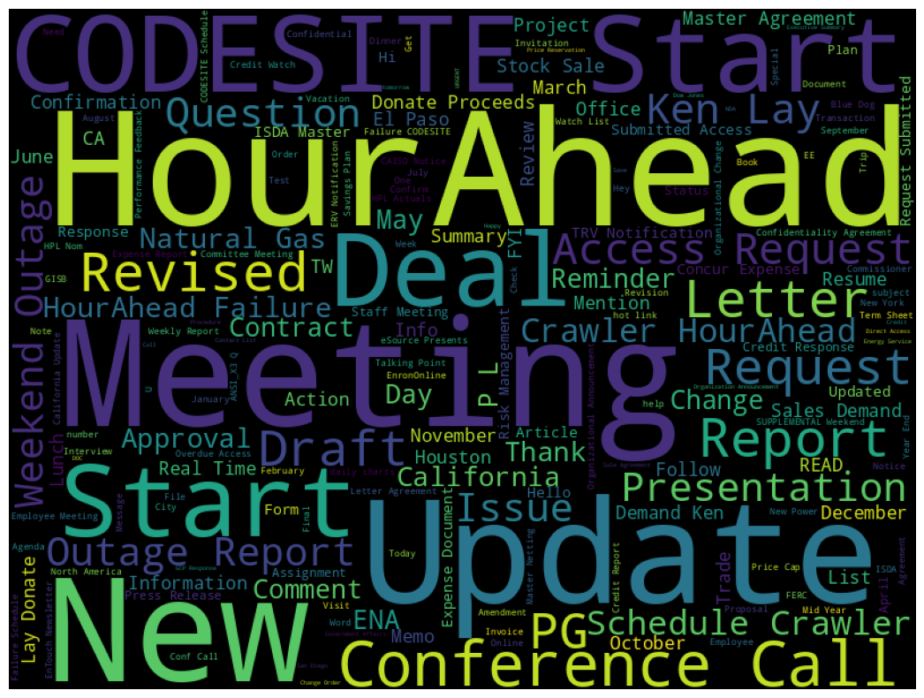
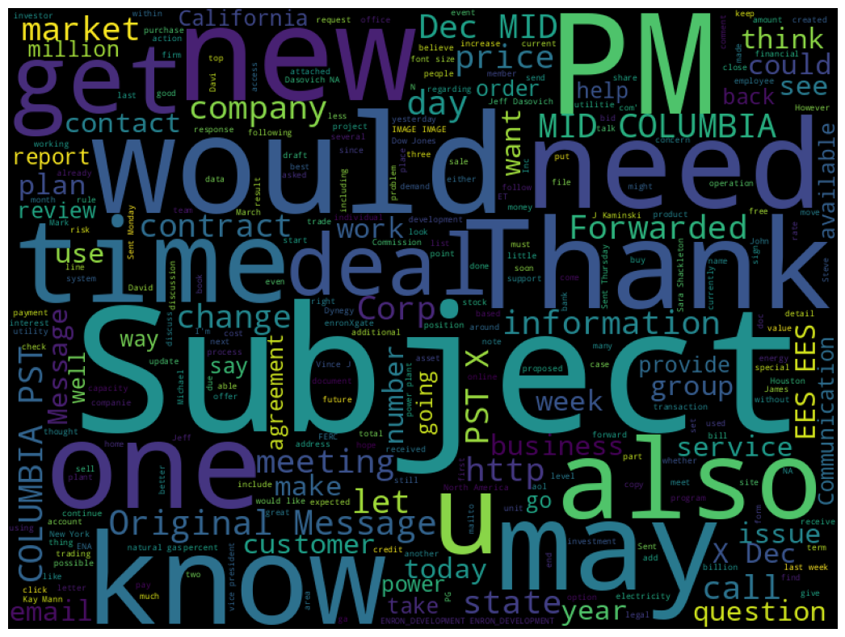
Common Words (Email Subject & Content)

Slide 20


Role Identification Using Keywords
Email | Count
all.houston@enron.com | 793
jeff.dasovich@enron.com | 754
sara.shackleton@enron.com | 539
tana.jones@enron.com | 458
steven.kean@enron.com | 443
mark.taylor@enron.com | 441
gerald.nemec@enron.com | 438
all.worldwide@enron.com | 416
sally.beck@enron.com | 405
These email addresses were found by isolating keywords that were part of one of two categories of interest:
Travel/Leave
Financial Terms
These email addresses were found to have received the most common occurrences of these keywords
Email | Count
tana.jones@enron.com | 3526
sara.shackleton@enron.com | 3487
jeff.dasovich@enron.com | 2296
all.worldwide@enron.com | 2255
mark.taylor@enron.com | 1952
steven.kean@enron.com | 1643
vince.kaminski@enron.com | 1471
louise.kitchen@enron.com | 1402
klay@enron.com | 1384
kay.mann@enron.com | 1269
Methodology
Conclusions
These are likely important employees in HR or People Ops., as they had to clear people’s vacation requests.
These are likely important employees in the financial department, as they were discussing financial topics often.

Slide 21
Network Analysis

Slide 22
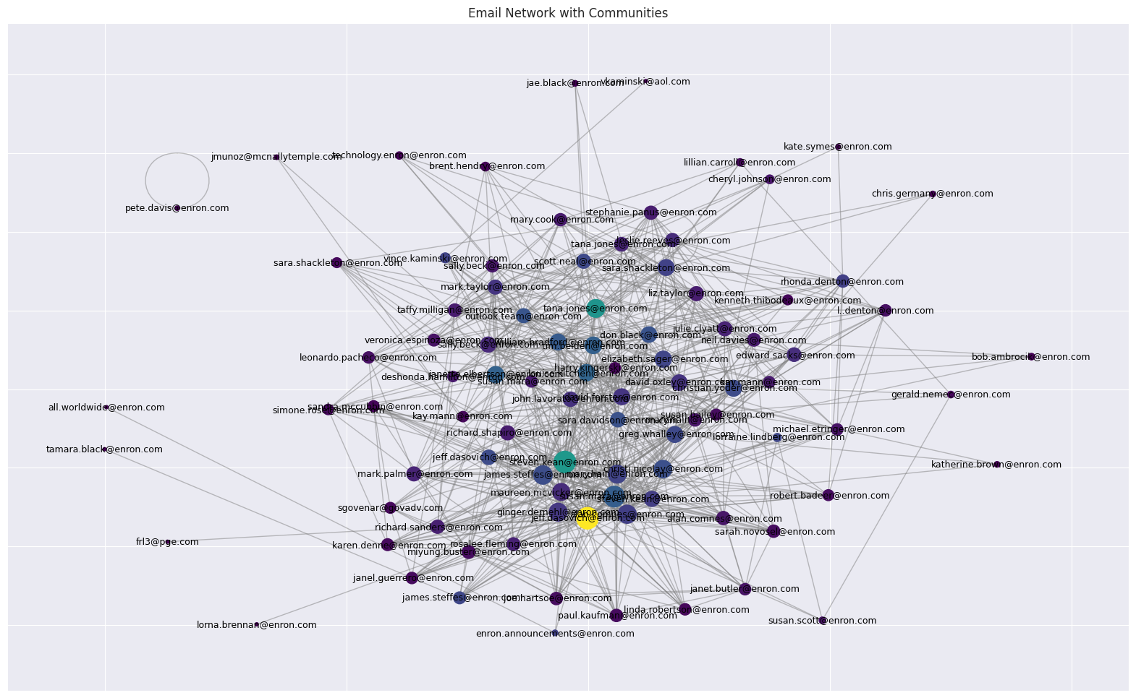
Email Network (With Communities)
Network was created over the time period 1998-2001
Nodes represent employees, edges represent emails sent between them
Methodology
Five distinct communities
Largest Community Size: 37
Average Community Size: 18.4
Largest Community:
Number of Nodes: 37
Average Degree Centrality: 0.35285285285285295
Initial Findings
Notes:
Jacob

Slide 23
Identifying Key Nodes in the Network
Node | Eigenvector Centrality
steven.kean@enron.com | 0.268222
susan.mara@enron.com | 0.253257
jeff.dasovich@enron.com | 0.24687
james.steffes@enron.com | 0.195959
alan.comnes@enron.com | 0.190417
Node | Betweenness Centrality
jeff.dasovich@enron.com | 0.110017
steven.kean@enron.com | 0.058767
tana.jones@enron.com | 0.056879
louise.kitchen@enron.com | 0.03541
janette.elbertson@enron.com | 0.034292
Node | Degree Centrality
jeff.dasovich@enron.com | 0.461538
steven.kean@enron.com | 0.461538
susan.mara@enron.com | 0.428571
james.steffes@enron.com | 0.340659
alan.comnes@enron.com | 0.32967
Takeaways
Steven Kean and Jeff Dasovich seem like incredibly important players
Tana Jones, Louise Kitchen, and Janette Albertson are likely important middle-men, but perhaps not much else
Notes:
Jacob

Slide 24
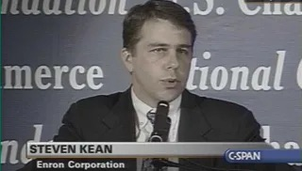
Network Analysis Summary
Measure | Maximum | Minimum | Average
Degree Centrality | jeff.dasovich@enron.com (0.46153846153846156) | all.worldwide@enron.com (0.01098901098901099) | 0.16411849020544667
Betweenness Centrality | jeff.dasovich@enron.com (0.11001678524667882) | all.worldwide@enron.com (0.0) | 0.013263789350745878
Eigenvector Centrality | steven.kean@enron.com (0.2682215472964166) | pete.davis@enron.com (1.3904119342338425e-31) | 0.0861974775825681
As executive vice president of the ENRON Corporation during its collapse, Steve Kean played an incredibly important role in the company. This is reflected by his high eigenvector score, which indicates that he was regularly in contact with the company’s most important people.
Steven Kean
While Jeff Dasovich may seem important based on the first two measures of centrality, qualitative assessment of the literature on the ENRON collapse indicates that he was not a major contributor to the incident. This likely indicates that he served a ‘middle-man’ role more than anything.
Jeff Dasovich

Slide 25
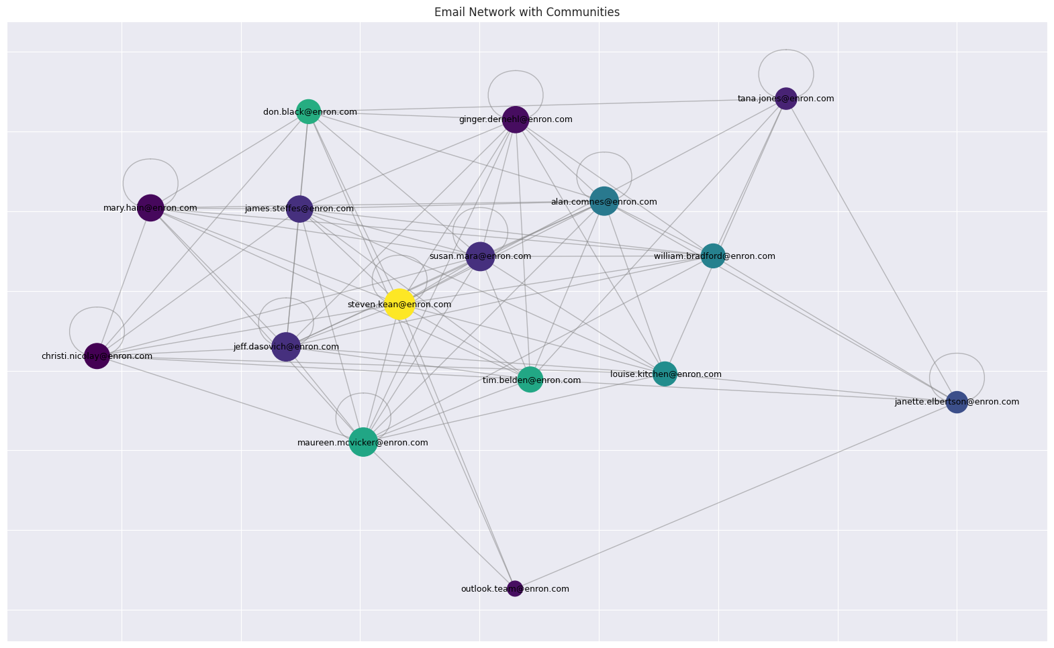
Communication Between Important Players
Goal: Discover unique communication patterns between the most important players
Conclusions
Steven Kean is the only member in the top group in his own distinct community
Potential inner circle: Steven Kean, Susan Mara, Jeff Dasovich, and Tim Belden
Need to investigate these further

Slide 26
Community Analysis
Description | Value
Number of Communities | 5
Largest Community Size | 37
Average Community Size | 18.4

Slide 27
Analysis of the Largest Community
Measure | Value
Number of Nodes | 37
Average Degree Centrality | 0.35285285285285295

Slide 28
Degree Centrality Analysis:
Maximum Degree Node: jeff.dasovich@enron.com (Degree: 0.46153846153846156)
Minimum Degree Node: all.worldwide@enron.com (Degree: 0.01098901098901099)
Average Degree: 0.16411849020544667
Betweenness Centrality Analysis:
Maximum Betweenness Node: jeff.dasovich@enron.com (Betweenness: 0.11001678524667882)
Minimum Betweenness Node: all.worldwide@enron.com (Betweenness: 0.0)
Average Betweenness: 0.013263789350745878
Eigen Vector Centrality Analysis:
Maximum Eigenvector Node: steven.kean@enron.com (Eigenvector: 0.2682215472964166)
Minimum Eigenvector Node: pete.davis@enron.com (Eigenvector: 1.3904119342338425e-31)
Average Eigenvector: 0.0861974775825681
Community Analysis:
Number of Communities: 5
Largest Community Size: 37
Average Community Size: 18.4
Analysis of the Largest Community:
Number of Nodes: 37
Average Degree Centrality: 0.35285285285285295

Slide 29
Conclusions

Slide 30
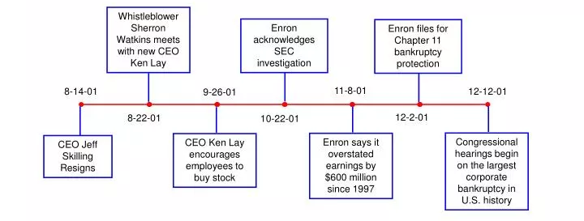

Key Takeaways
General Volume Prediction: Attempted to train LSTM to predict email volume (unsuccessful)
Granger Causality: Discovered Vince Kaminski’s volume of emails is useful in predicting Kay Mann’s
Time Series
Role Identification: Discovered important people in the finance and HR departments
Sentiment Analysis: Sentiment among C-Suite employees decreased in 2001
NLP
Interesting Insight: As the ENRON scandal heated up, email volume increased and overall email sentiment score decreased.
Discovered five distinct communities (among network of people involving the top 20 senders/receivers)
Identified Steven Kean as a very important player
Potentially found a hidden inner circle among the most important employees
Network
Problem & EDA
…
Key Takeaways
Next Steps
Notes:
Jacob

Slide 31


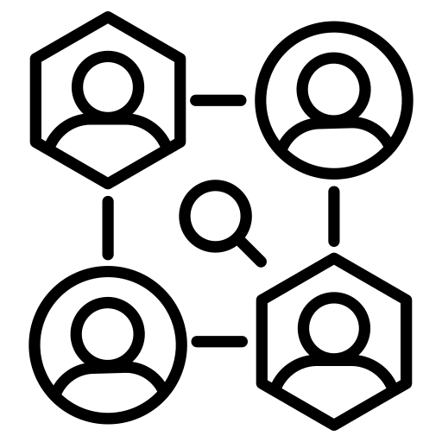
Next Steps
Perform deeper NLP analysis on key players in the network, attempt to identify possible nefarious activity within the contents of their emails
Use more powerful predictive machine learning models to try to predict ENRON’s stock price based on email content and volume
Conduct more comprehensive overall network analysis, and take a closer look at the potential inner circle of employees
Problem & EDA
…
Key Takeaways
Next Steps
Notes:
Jacob

Slide 32
Thank You!

